Slide 1
IST 707: Project Checkpoint
Presented by: Huzaif Kherani, Sai Bolla, Shabib Khan, Samar Zemeer

Slide 2
Introduction
Flying has long been the preferred method of transportation since it is quick, inexpensive, and so convenient. As of June 2019, the FAA reported that 2,781,971 people flew every day in the US.
The NTSB focuses initiatives to lower General Aviation accidents, which were redoubled with the Federal Aviation Administration's Safer Skies Initiative in 1998. The fatality rate in general aviation has declined over the past 22 years.
Accidents still occur, though, and there is some evidence that indicates an increase in the number of accidents that indicate hazard exposure. The accident data indicate that there is still more the aviation community needs to understand about the factors involved in an accident sequence.

Slide 3
Business Problems
To anticipate and classify the severity of any airplane accident based on past incidents?
What are the different factors that affects the severity of an airplane crash?
Factors related with the aircraft (Cockpit)
Factors in conjunction with human element and other externalities.

Slide 4
Data Preprocessing: Part - 1
The following 12 variables were chosen for further analysis as “Sub-dataset: 1”
Severity | Days_Since_Inspection | Cabin_Temperature | Violations
Safety_Score | Total_Safety_Complaints | Accident_Type_Code | Adverse_Weather_Metric
Control_Metric | Turbulence_In_gforces | Max_Elevation | Accident_ID
The “Sub-dataset: 1” consists of 12 columns; 10,ooo rows in train data and 2500 rows in test data.

Slide 5
Data Preprocessing: Part - 2
The following 40 variables were chosen for further analysis as “Sub-dataset: 2”
Mid-air | Basic weather conditions | Sightseeing flight | Med certificate validity
Ground collision | Flight plan type | Air-medical flight | Professional pilot
Airport location to crash | Homebuilt | Airspace | Highest certificate
Atmospheric lighting | Fixed-retractable gear | Crew position code | Total flight hours
Wind gusts indicated | Flight purpose | Age | Total flight hours
Accident Injury level | Second pilot on board | Sex | Hours last 90-days

Slide 6
Data Preprocessing: Part - 2
The following 40 variables were chosen for further analysis as “Sub-dataset: 2”
Hours last 30-days | Total hours single-engine | Defining events | Report narrative
Hours last 24-hours | Total hours at night | Occurrences | Factual narrative
Total hours make | Engine type | Causes | Cause narrative
Total hours multi-engine | Multi-engine aircraft | Factors | Incident narrative
The “Sub-dataset: 2” consists of 40 columns; ~18,ooo rows and incorporate the following categories of data: Pilot, Airplane, Weather Conditions, and FAA Reports.

Slide 7
Sub-dataset : 1

Slide 8
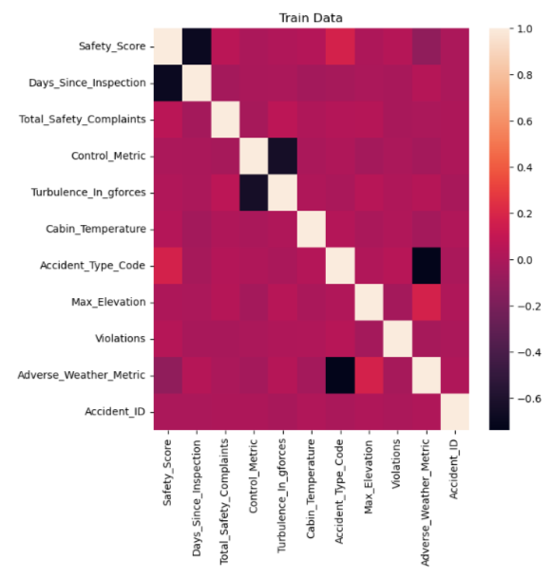
Exploratory Data Analysis
The following correlation matrix provides the following inferences:
Days since inspection has a strong -ve correlation with Safety Score
Accident type code has a weak +ve correlation with the Safety Score
Adverse Weather Metric has a strong -ve correlation with Accident Type Code
Adverse Weather Metric has a weak +ve correlation with Max Elevation
Turbulence in gforces has a strong -ve correlation with Control Metric

Slide 9
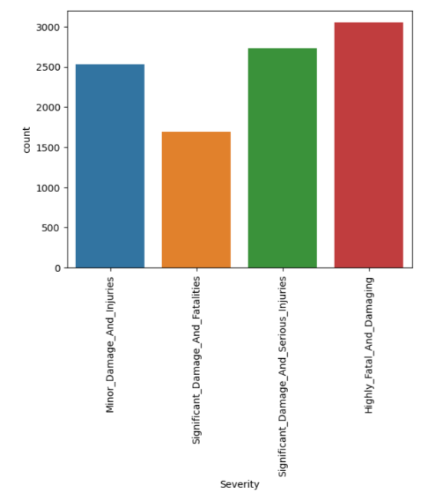
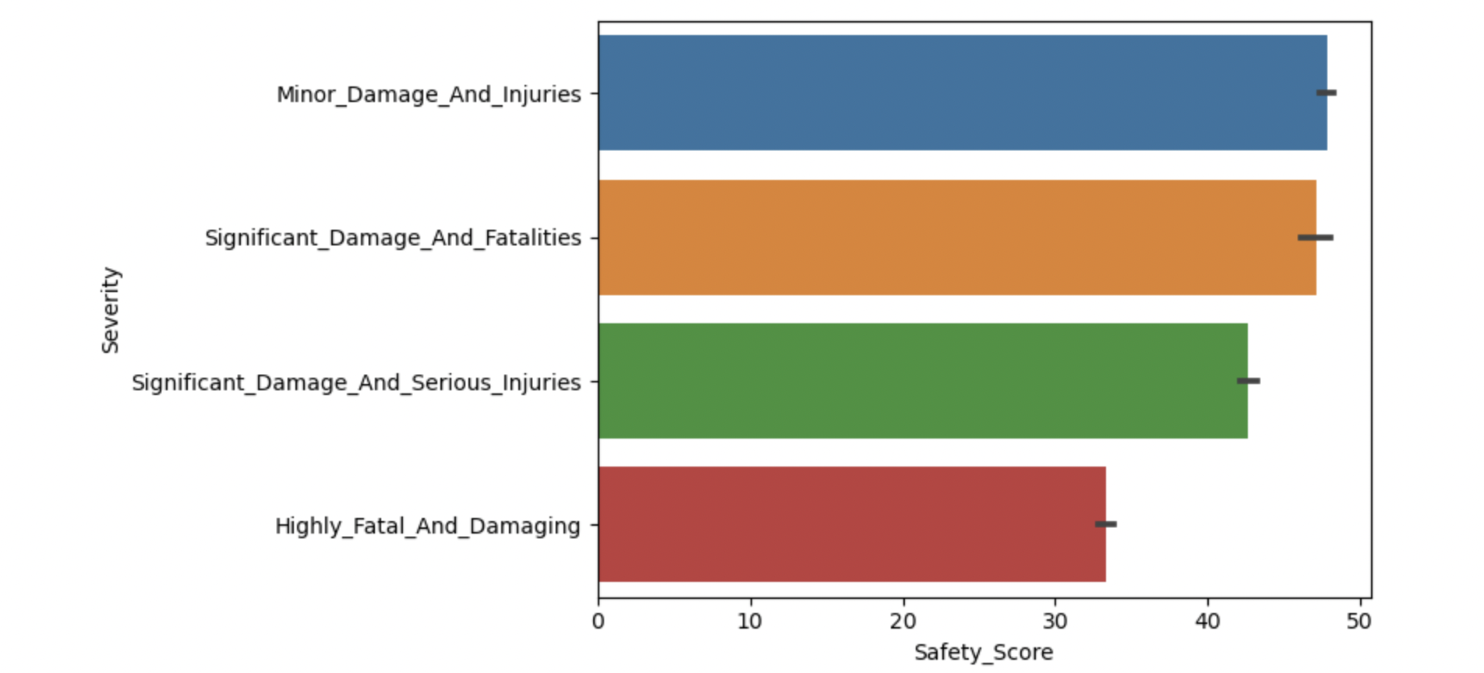
Exploratory Data Analysis
The following bar graphs showcase the accident severity, and relation between accident severity and days since inspection

Slide 10
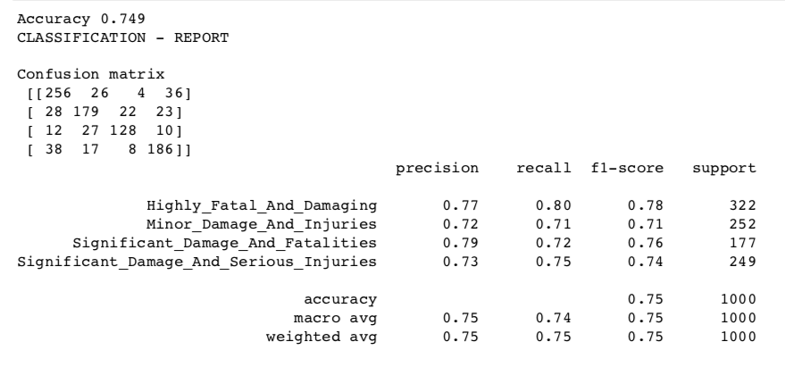
Data Mining - Decision Tree
The following features were selected for building a Decision Tree:
Severity | Days_Since_Inspection | Cabin_Temperature | Violations
Safety_Score | Total_Safety_Complaints | Accident_Type_Code | Max_Elevation

Slide 11
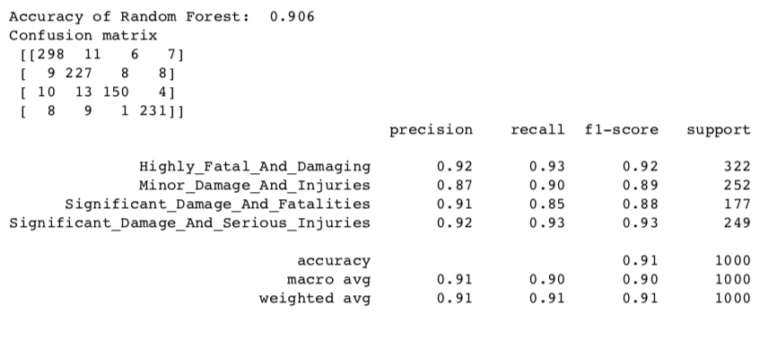
Data Mining - Random Forest

Slide 12
Sub-dataset : 2

Slide 13
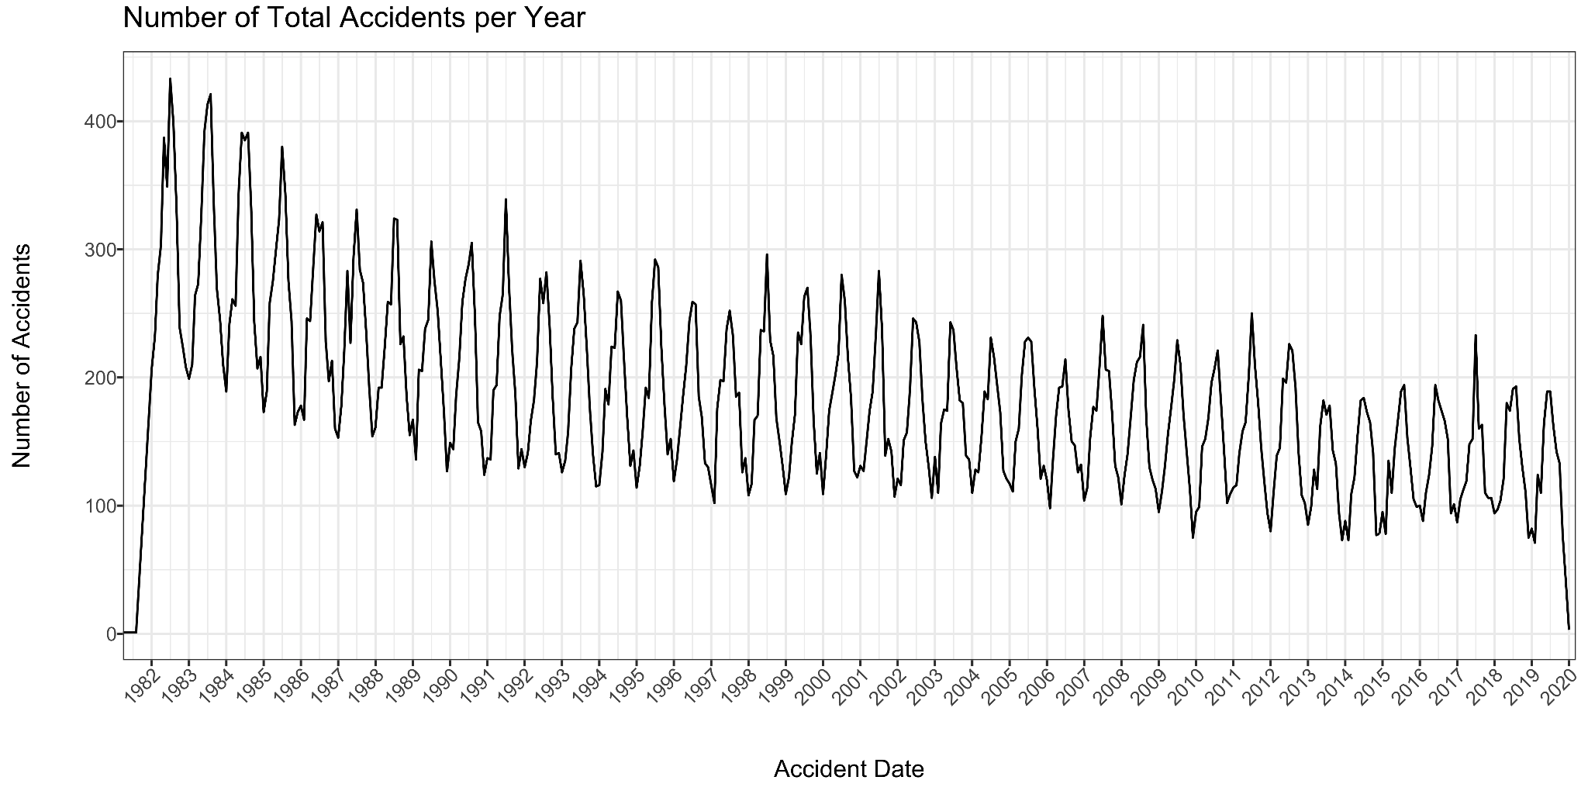
Exploratory Data Analysis
Interpretation: Over the years, we have noticed a general decline in the frequency of accidents. We can also see that the seasonality of flights is significant in this situation.

Slide 14
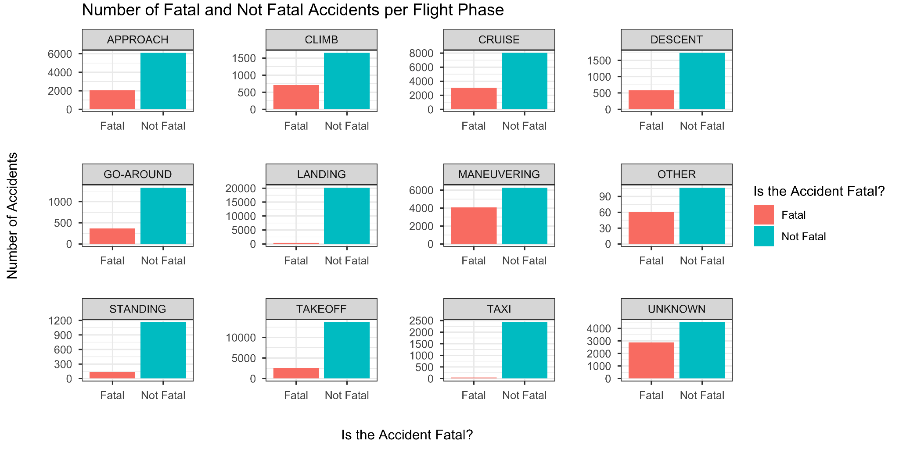
Exploratory Data Analysis - Flight Phase
Interpretation: It appears that maneuvering—that is, turning, climbing, or lowering near to the ground—was when deadly accidents happened the most. This is in line with the FAA's statements.

Slide 15
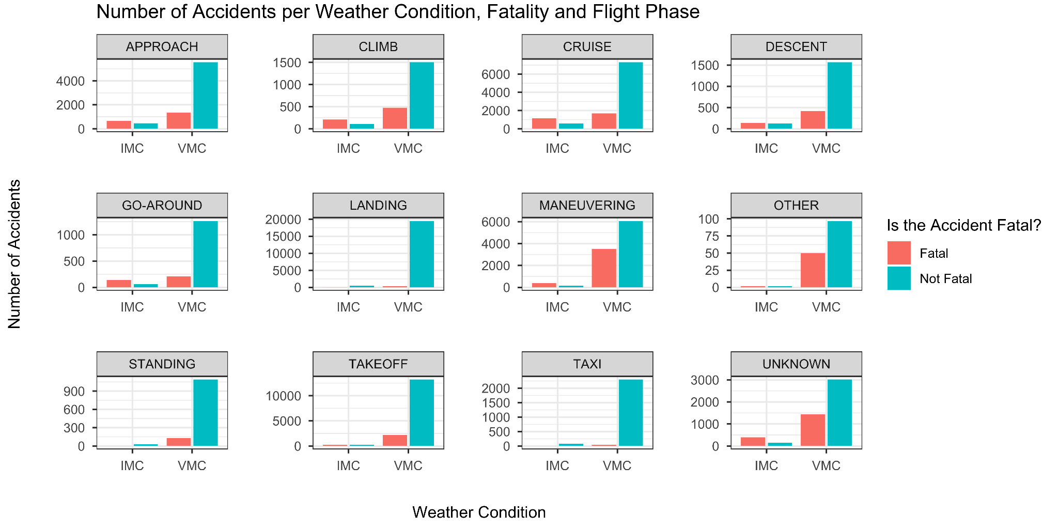
Exploratory Data Analysis - Storms
Interpretation: As expected, most accidents occur in visual meteorological condition (VMC), which is an usually favorable weather condition. Contrarily, the majority of incidents that occur in Instrument Meteorological Conditions (IMC, also known as severe weather), result in death.

Slide 16
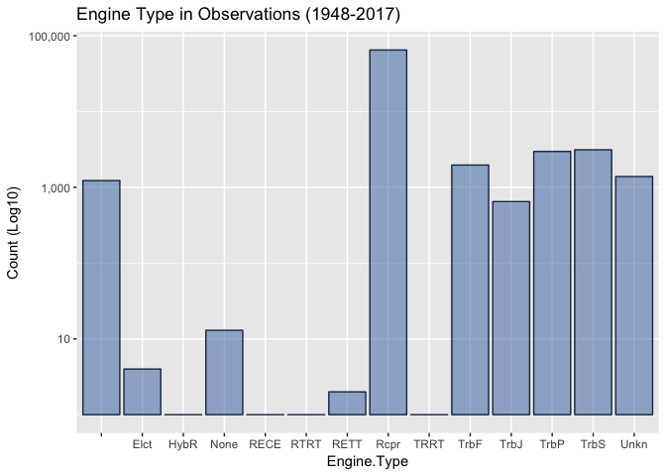
Exploratory Data Analysis - Engine Type
Interpretation: The plots above show that reciprocating engine types, which were common in commercial aircraft, especially those produced during the 20th century, make up the majority of the engine types in the recorded incidents.

Slide 17
Our Future Pathway

Slide 18
Further Process
Subset 1
Check other features in dataset that will affects the target variable.
Build the future models to check which models has better precision.
Compare and evaluate the models/results.
Make Functional/Technical specifications.
Subset 2
Explore more on Exploratory data analysis
Build ML models on data.
Compare and evaluate the models/results.
Make Functional/Technical specifications.

Slide 19
Questions?

Slide 20
Thank You

